Slide 1
Sales Analysis & Recommendations
Project Overview for Sales Team
Name: Muhammad Yasir
Date: 28-11-2025

Slide 2
Project Overview & Business Goals
Understand effectiveness of different sales methods (Email, Call, Email + Call)
Evaluate revenue performance and customer reach
Provide actionable recommendations to optimize sales efforts
Best sales method and Business Metric

Slide 3
Data & Approach
Dataset: 15,000 rows, 8 columns (week, sales_method, customer_id, nb_sold, revenue, years_as_customer, nb_site_visits, state)
Data validation missing values of “revenue” fill with median and text standardization of sales_method column. And Outlier remove from year_of_customer column more than 41 year customers
Exploratory analysis distribution, correlation, trends
Metric definition: Average Revenue per Customer (ARPC)
Tools: Python libraries pandas, seaborn, matplotlib

Slide 4
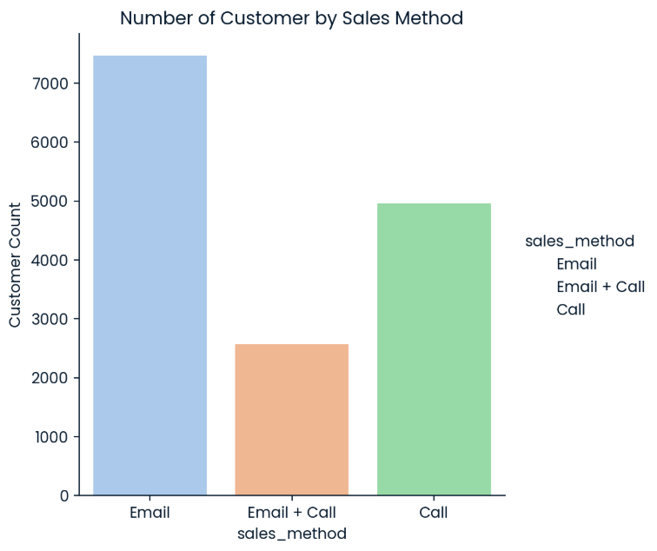
Customer Distribution by Sales Method
I analyzed the distribution of the sales
methods to understand how many
customers were reached through
each approach.
Email: 7,466 customers
Call: 4,962 customers
Email + Call: 2,572 customers

Slide 5
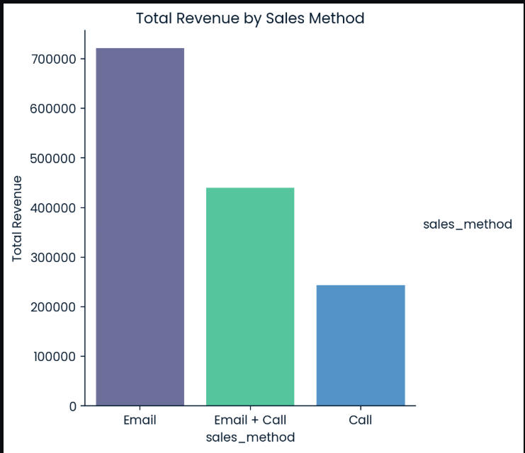
Revenue by Sales Method
These insights help the business
decide whether to focus more on
Email + Call for premium clients
and Email for broad outreach.
Email: $721,006
Call: $243,763
Email + Call: $439,492

Slide 6
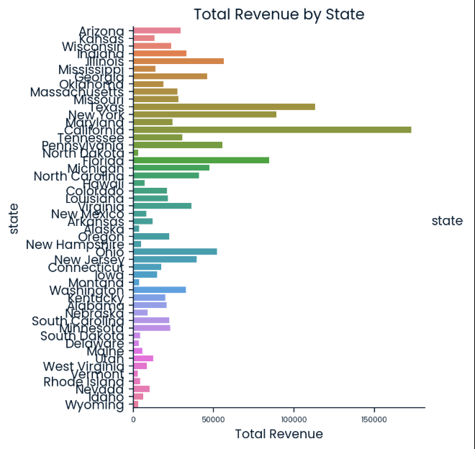
Revenue by State
The chart shows clear variation
in total revenue by state.
Top 3
California = $ 172944
Texas = $ 113275.45
New York = $ 89150

Slide 7
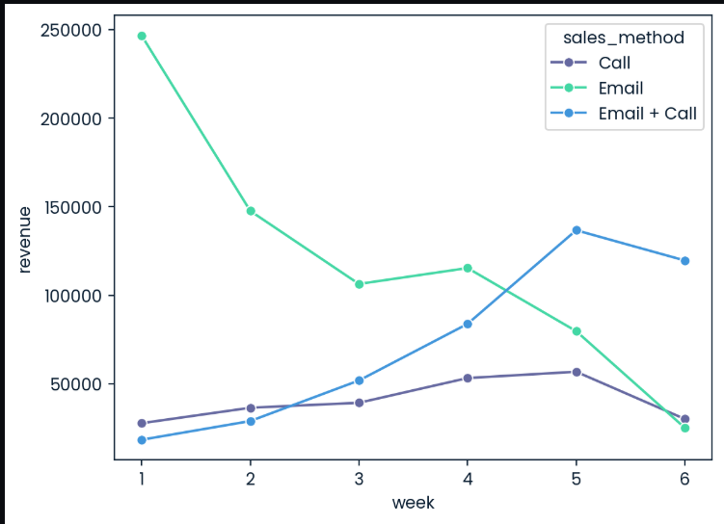
Weekly Revenue Trends
Email method dominates weekly revenue overall
Email + Call is consistent and high per customer
Call method is least efficient

Slide 8
Metric to Monitor: ARPC
Formula:
ARPC = Total Revenue / Number of Customers
Helps track sales method effectiveness over time
Current ARPC:
Email + Call: 170.85 (highest)
Email: 96.54
Call: 49.13

Slide 9
Recommendations to Sales Team
Prioritize Email + Call for high-value customers
Maintain Email for broad outreach
Reduce reliance on Call-only approach
Track ARPC weekly/monthly to monitor efficiency

Slide 10
Summary & Next Steps
Email + Call is most effective per customer
Email reaches the most customers overall
Call-only is least efficient
Next steps: implement recommendations and monitor ARPC regularly
Thank You 💖

